Slide 1
Time series analysis about
the stock data of Tesla motors
How efficient market hypothesis well explained the stock price
in high-tech Industry/business ?

Slide 2
Contents
Intro
Data description
Model fitting
Model diagnostic
Model Selection
Conclusion
Prediction

Slide 3
Introduction
According to Efficient Market Hypothesis,
The price of the stock should be represented with all available information
The price of the stock is the result from reasonable decisions of people
Past (weak), available(semi strong), and all (strong) information already affect the price
How about High-tech industry/business ?
There are lots of vapor wares
Technology improvement is so fast and accessibility are high
Sometimes there are no certain industry or market of it

Slide 4

Introduction
High-Tech industry
(electric vehicles, energy storage and solar panel manufacturing … etc.)
Vapor wares
(Model Y, Model X , and etc.)
People’s expectations
(CEO effect, Media and etc.)

Slide 5
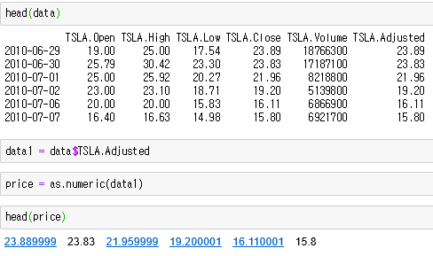
Data Description
Load Data and description
 | Mean | Median | STDEV | Skewness | Excess Kurtosis
Price | 181.75 | 211.01 | 113.56 | -0.229 | -1.3217

Slide 6
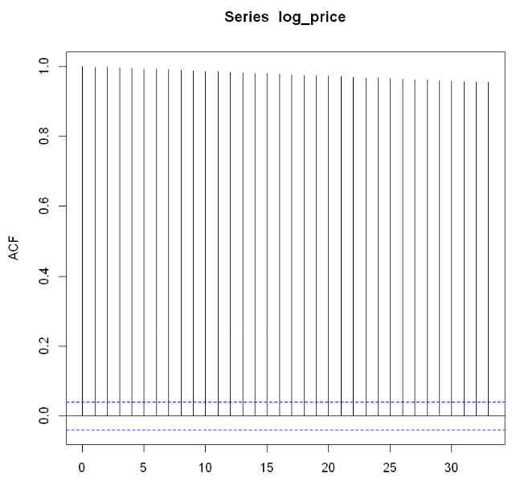
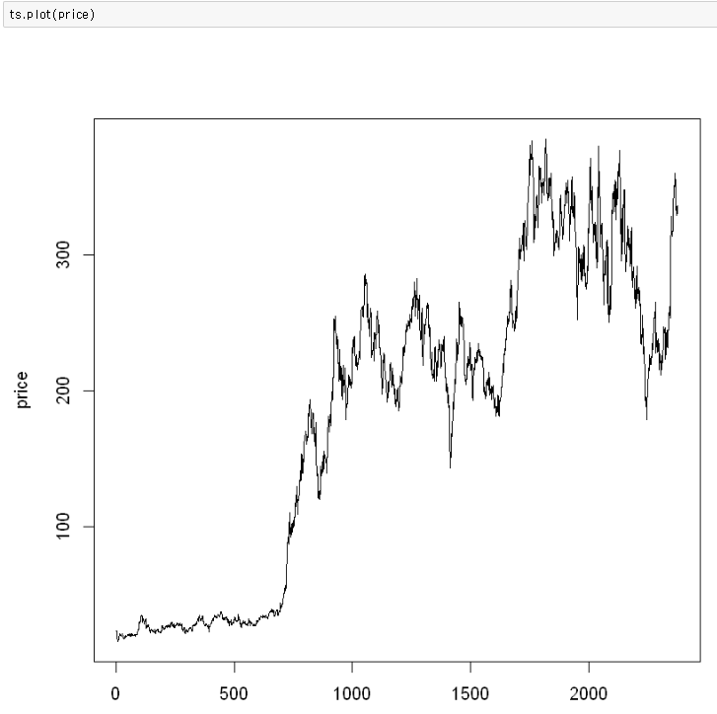
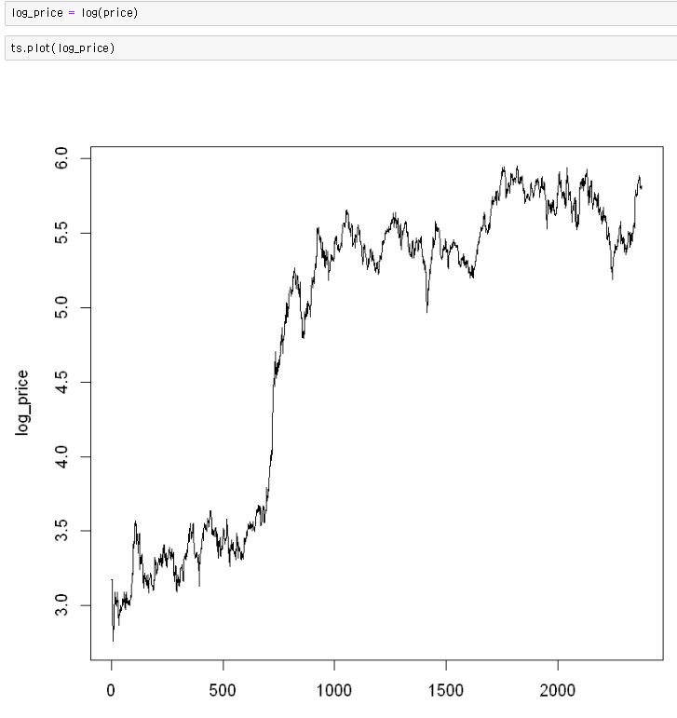
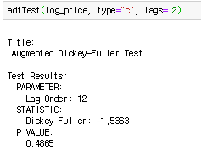
Model Fitting
price
Log_price
ACF of Log_price
Data have unit root, follows Random walk and Non-stationary,
So we made a difference to the return

Slide 7
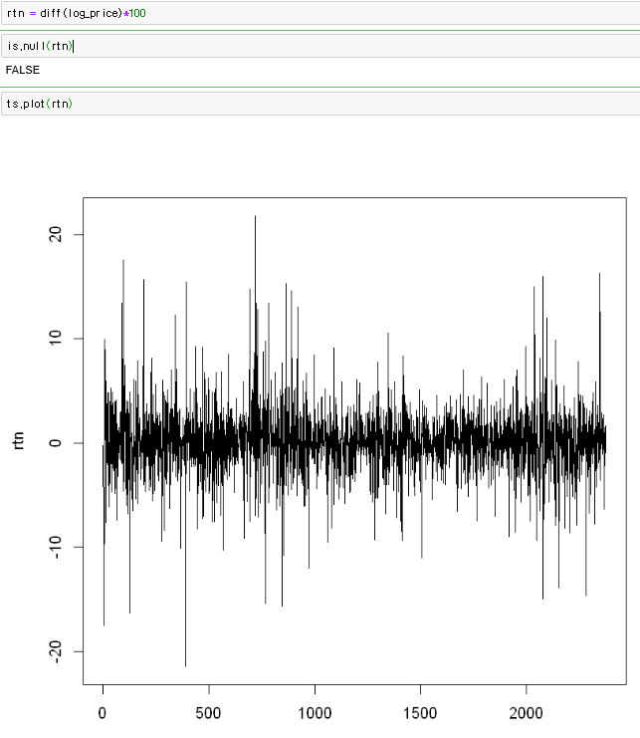
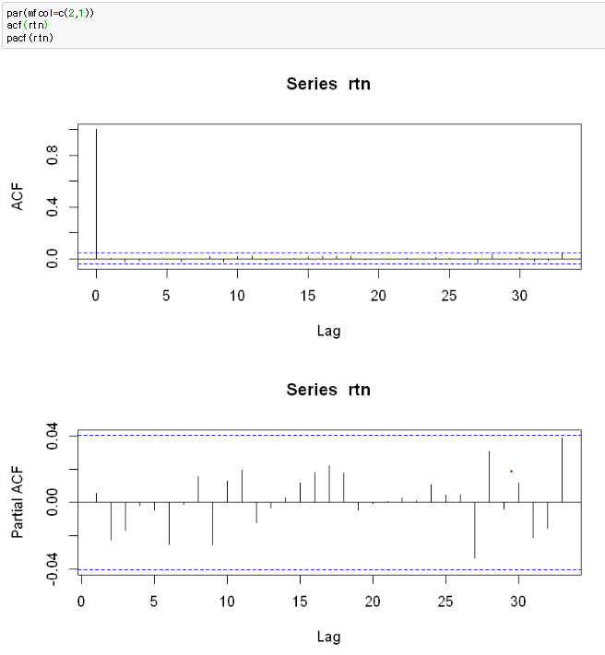
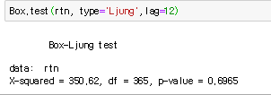
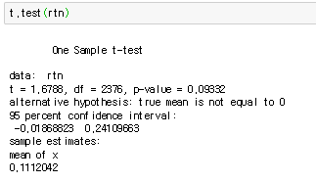
Model Fitting
Return (= diff(log_Price) *100 )
ACF / PACF of Return
Data looks stationary but, there is no serial correlation.
Based on ACF and PACF plot, data looks like White noise.
So, we suggest the Volatility model !

Slide 8
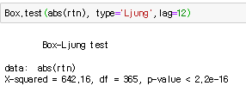
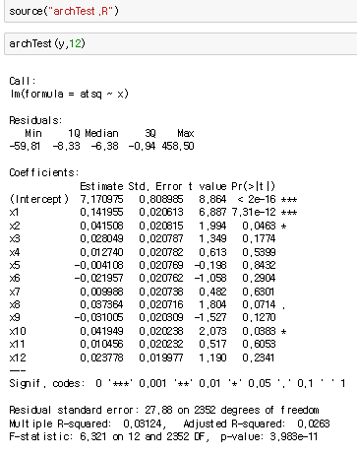
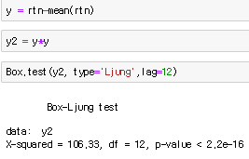
Model Fitting
P-value is smaller than 0.05. So, we can reject the null hypothesis
which means there is serial correlation in absolute residuals.
It means absolute residuals are not randomized.
P-value is smaller than 0.05. So, we can reject the null hypothesis
which means there is heteroscedasticity in the residuals.

Slide 9
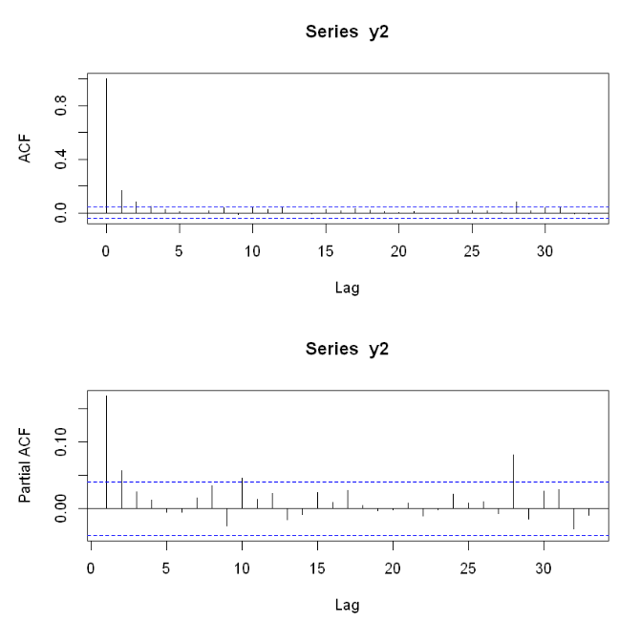
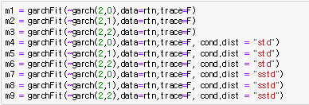
Model Fitting
We can check 2 lags are higher than 0.05
which means in GARCH (p , q), we should fix p as 2
and then make 9 models (with 3 different distributions)

Slide 10
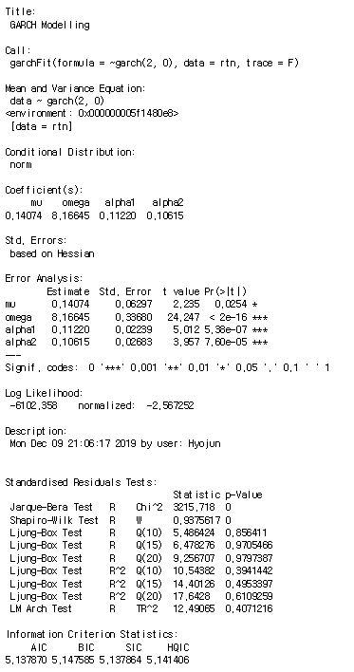
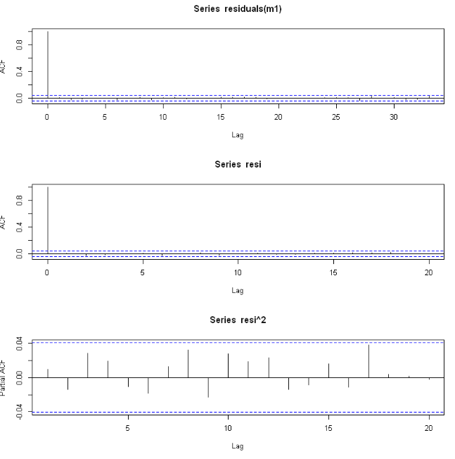
Model Diagnostic
Model 1
GARCH(2,0)

Slide 11
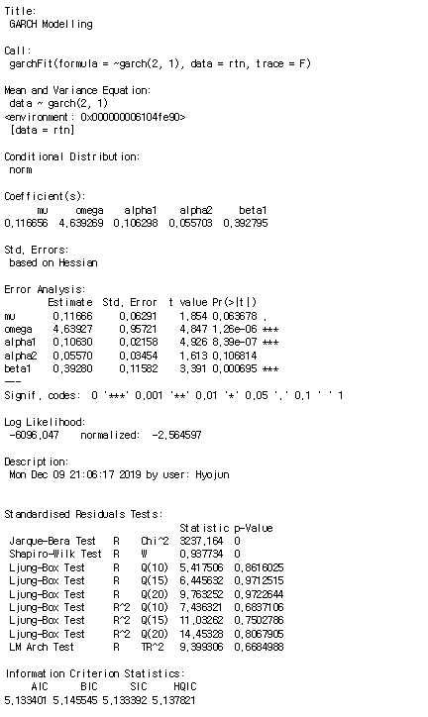
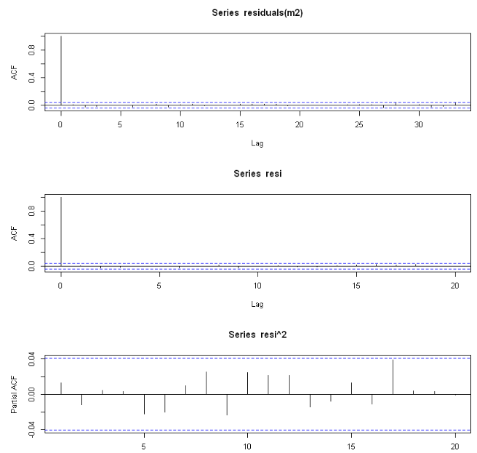
Model Diagnostic
Model 2
GARCH(2,1)

Slide 12
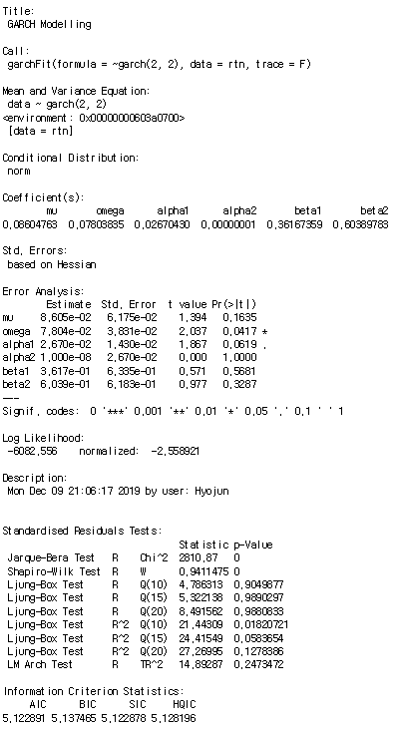
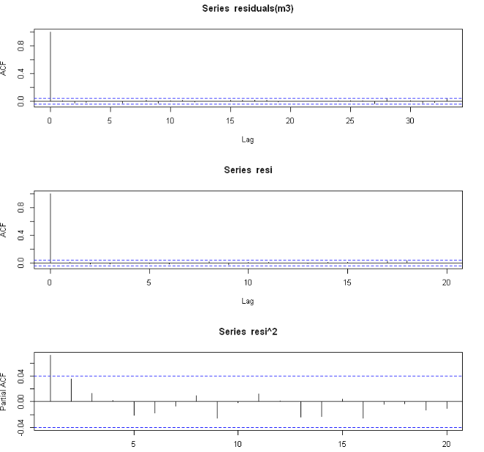
Model Diagnostic
Model 3
GARCH(2,2)

Slide 13
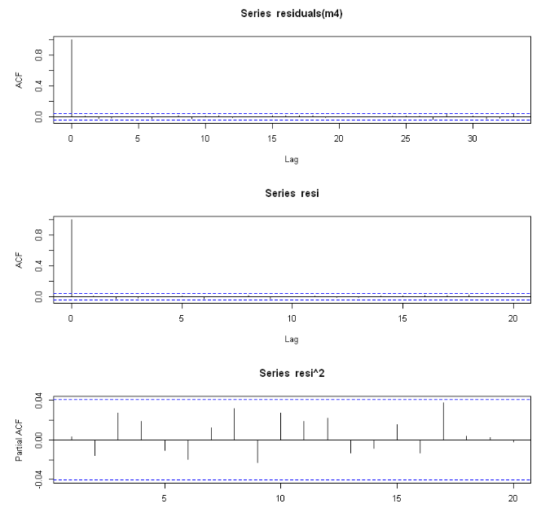
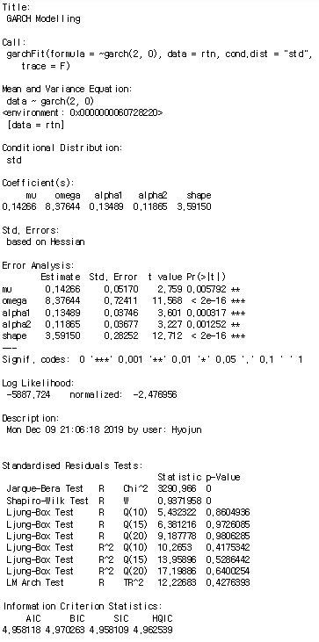
Model Diagnostic
Model 4
GARCH(2,0)
with std

Slide 14
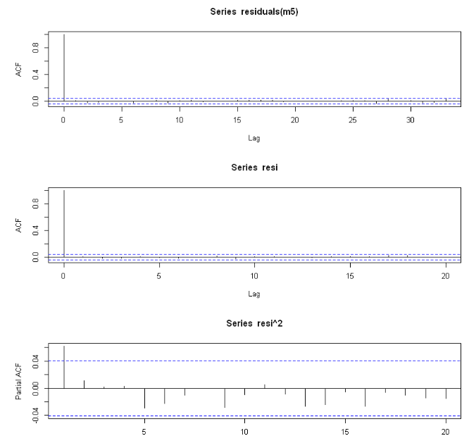
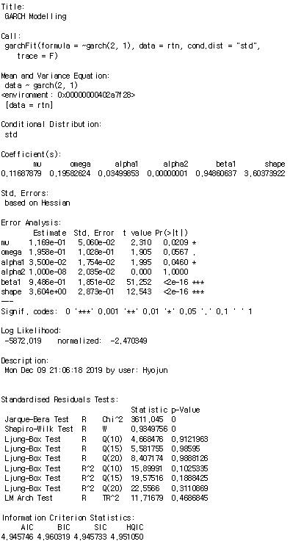
Model Diagnostic
Model 5
GARCH(2,1)
with std

Slide 15
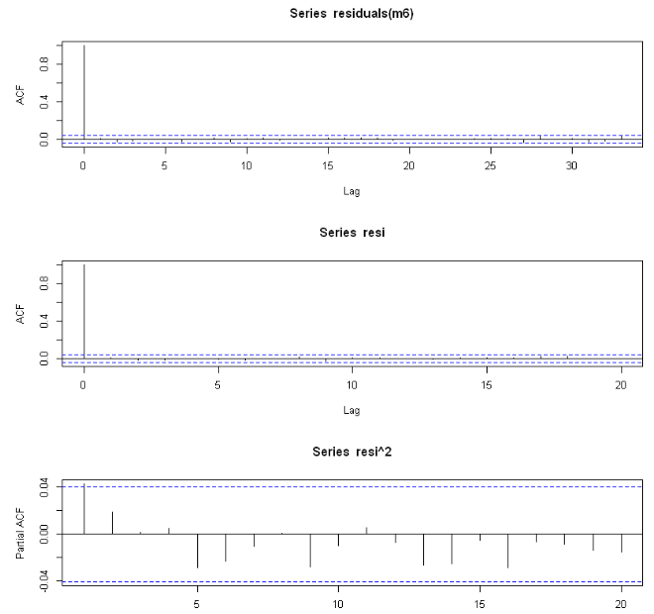
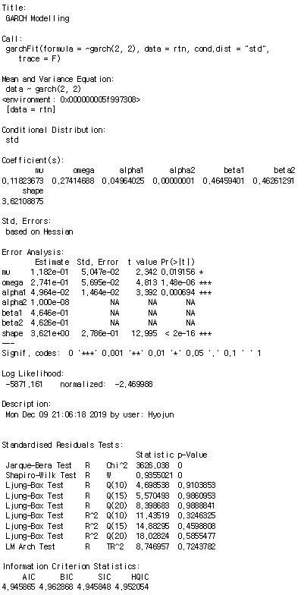
Model Diagnostic
Model 6
GARCH(2,2)
with std

Slide 16
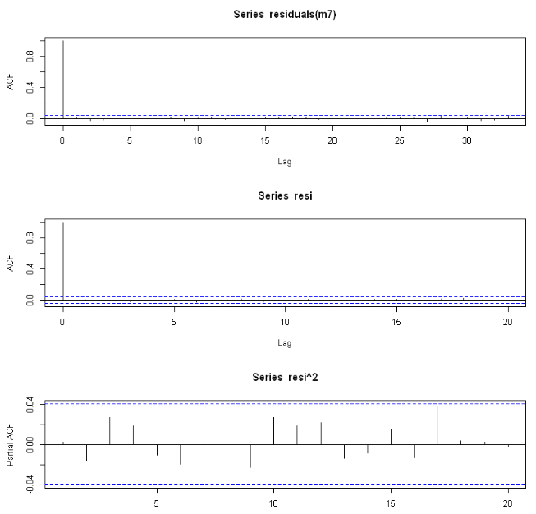
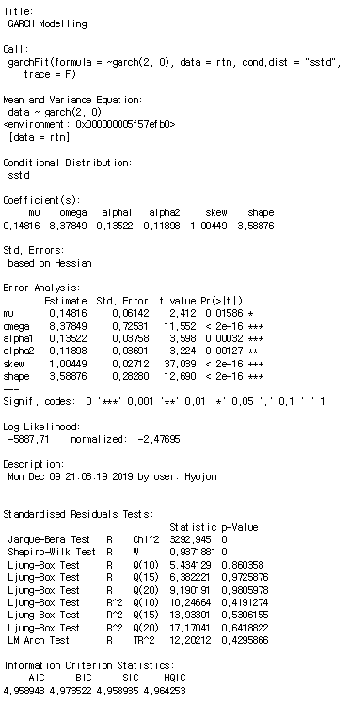
Model Diagnostic
Model 7
GARCH(2,0)
with sstd

Slide 17
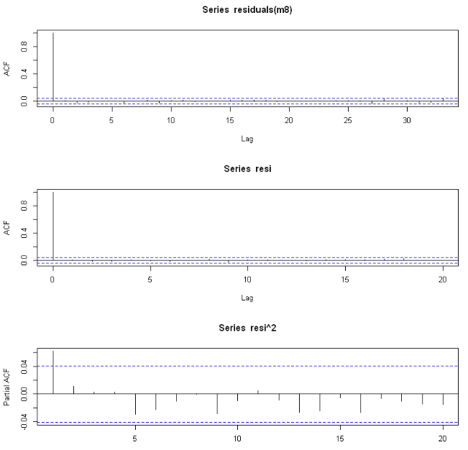
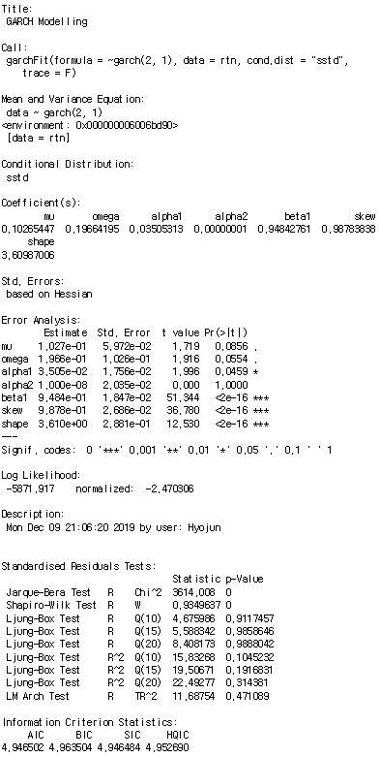
Model Diagnostic
Model 8
GARCH(2,1)
with sstd

Slide 18
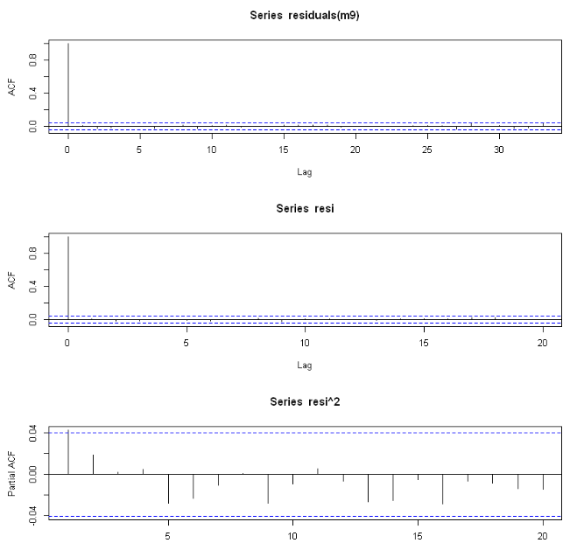
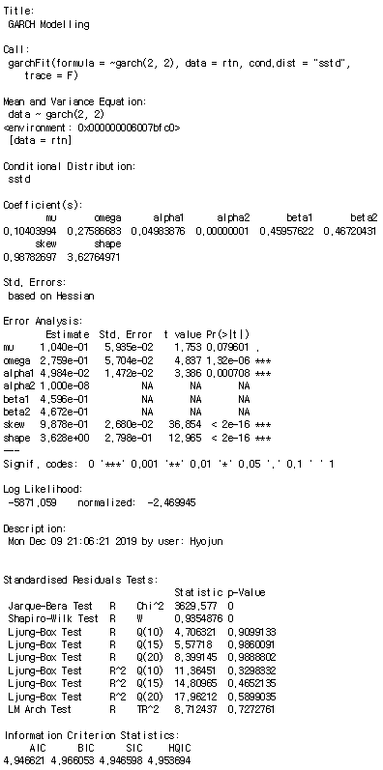
Model Diagnostic
Model 9
GARCH(2,2)
with sstd

Slide 19
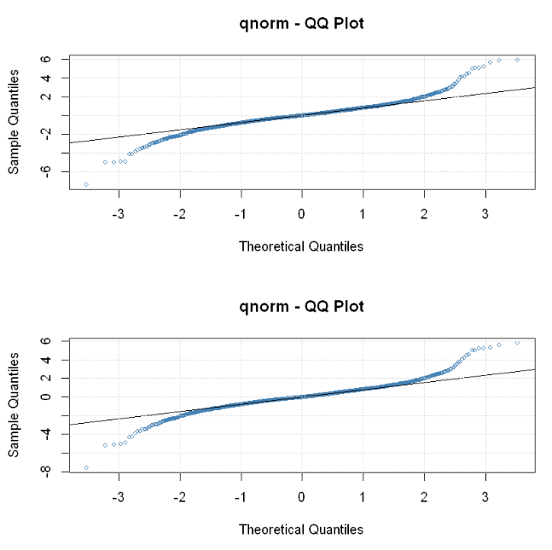
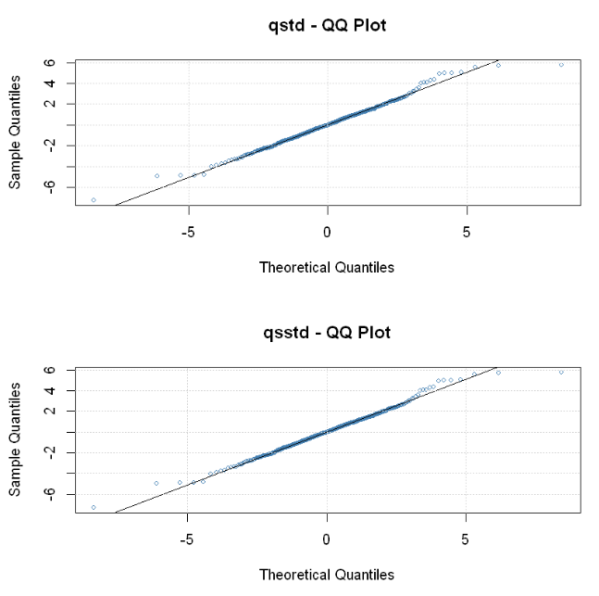
Model Selection
Model 1
GARCH(2,0)
Model 4
GARCH(2,0) with std
Model 2
GARCH(2,1)
Model 7
GARCH(2,0) with sstd
So, We select model 4, GARCH(2,0) with student-t innovations (conditional distribution)

Slide 20
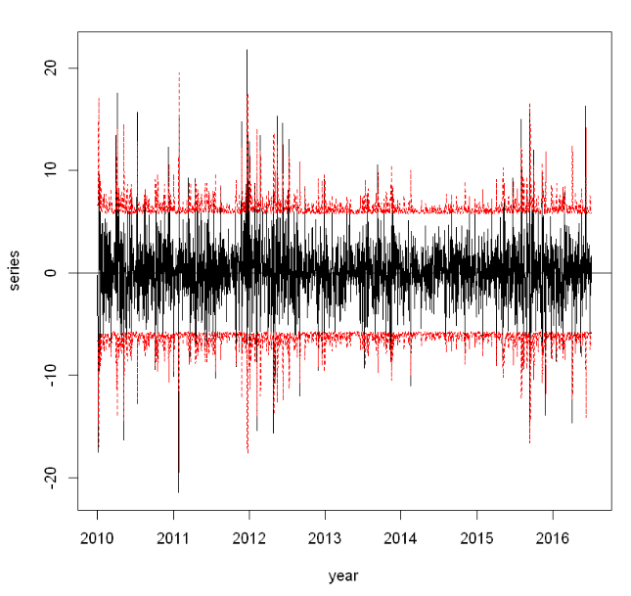
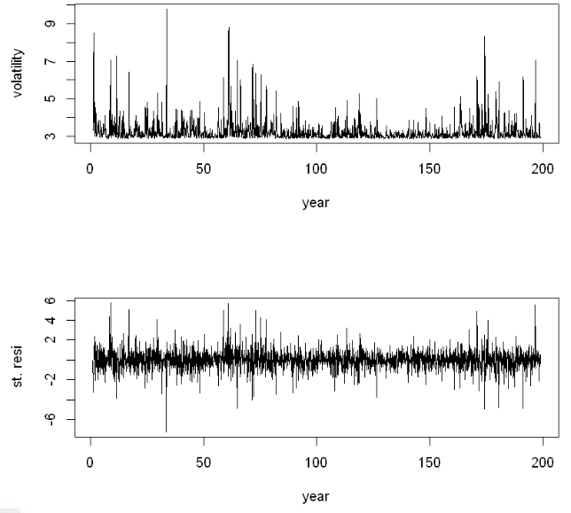
Conclusion
Volatility & Residual plot of fitted model
Comparing return value with 95% of interval

Slide 21
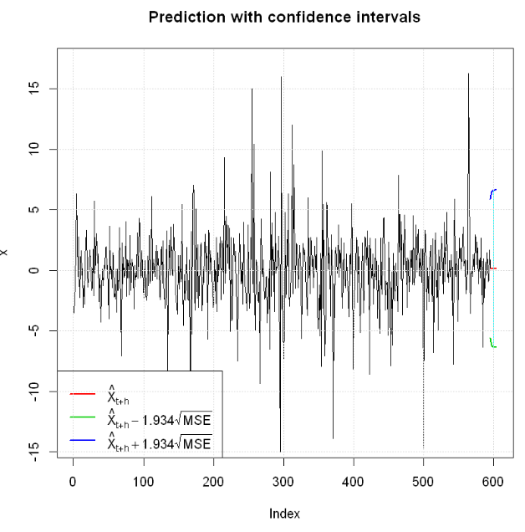
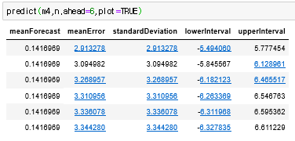
Prediction
Prediction of the return on December of 2019

Slide 22
Thank you For listening

